Slide 1
Algorithms Behind Modern Storage Systems
By Alex Petrov Atul Jeph 2020CS10329 Aryan Gaurav 2020CS10327

Slide 2

What is the Paper about?
The amount of data processed by applications is constantly growing. With this growth, scaling storage becomes more challenging.
Database systems and their different trade-offs: read, write and storage overhead.
Storage System design approaches in modern databases:
- read-optimized B-Trees
- write-optimized LSM-Trees.
The RUM conjecture.
Notes:
Impossible to optimize systems in all directions.

Slide 3
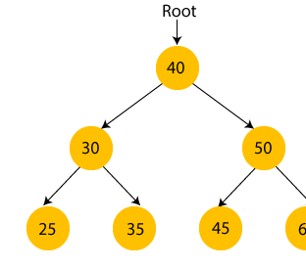
Basic Storage Systems: Binary Trees
Three types of nodes: Root, intermediate and leaf.
Parent-Children relation
Left and Right subtrees: keys allocation.
Insertion of randomly ordered keys: unbalanced depth deepening.
Tree depth minimization technique: Balancing.

Slide 4
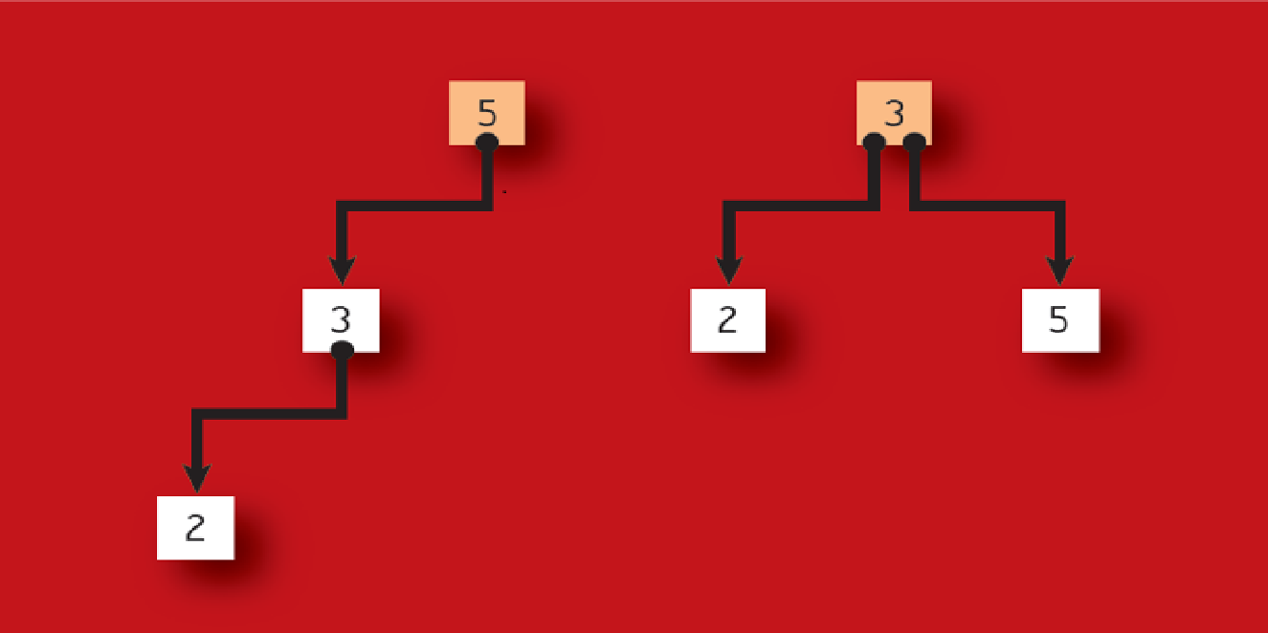
Binary Trees: Balancing via Rotation
Unbalanced Binary tree: Height difference
between subtrees > 1.
Balancing: Push the parent node of longer
subtree down by 1.
Balancing: Pull the child node of longer subtree
up by 1.
Net height of the tree decreases by 1.
Binary Trees : Inefficient because of low fanout
and frequent balancing.
A more efficient version: B-Trees.

Slide 5

What are B-Trees?
Read optimized indexing data structure.
Order : Maximum number of children.
Order-1: Maximum number of keys in
a node.
Ceil(Order/2): Minimum number of
children.
Ceil(Order/2)-1: Minimum number of
keys.
Each node has keys, data pointers and
block pointers.

Slide 6
B-Trees: Properties
Sorted: Keys are sorted, allowing sequential scans
Self- Balancing: When a node is full, it splits into 2;
when the occupancy is too low, neighbouring nodes
merge.
Mutable: Inserts, updates and deletes are performed
on disk in place.
Notes:
To make in place updates possible, certain amount of space overhead is required

Slide 7
B-Trees: Characteristics
Branching Factor: The number [N] of child pointers.
Internal and root nodes can hold upto [N-1] keys.
Occupancy: Number of child pointers the node holds,
out of the maximum possible [N].
Height: Number of B-Tree levels; signifying number of
pointers to be followed during lookup.
Notes:
Maximum N-1 keys and N subtrees. Pointer i from entry Ki points to a node such that K(i-1)<=K{searched}<Ki. Left subtree of Ko, all <= Ko (B+trees). Right subtree of of K(N-1), all > K(N-1)

Slide 8
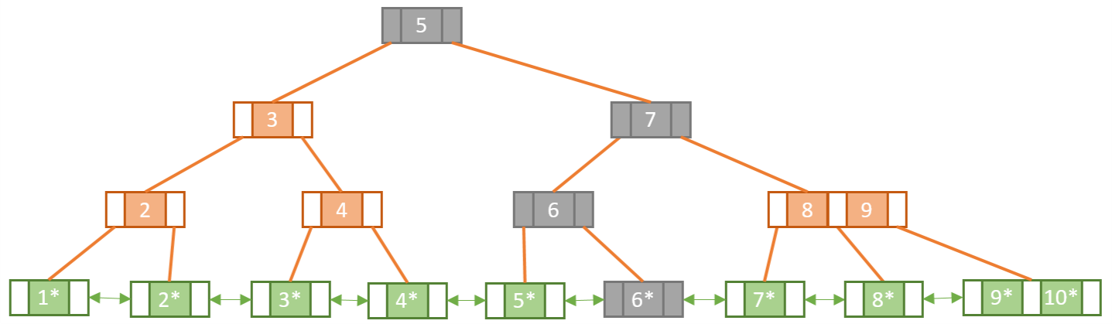
B+Trees
Modern variant of B-Trees.
Consists of an additional level of linked leaf
nodes holding the values.
Internal nodes do not contain values (data
pointers); they only have keys.
Nodes are wider than B-Trees.
B-Trees are deeper in depth than B+Trees.
Search time: Faster than B-Trees.
Notes:
Wider means more key storing capacity.

Slide 9
B+Trees: Wider, Shallower, Faster
Wider: Since internal nodes only have keys,
not data, the space occupied by data in
B-trees, is used up for accommodating
more keys in B+Tree. Hence, Wider nodes.
Shallower: As width of node increases,
depth decreases for same number of keys.
Faster: It takes only one root-to-leaf pass
to reach the leaf level, followed by binary
searches for range queries.

Slide 10
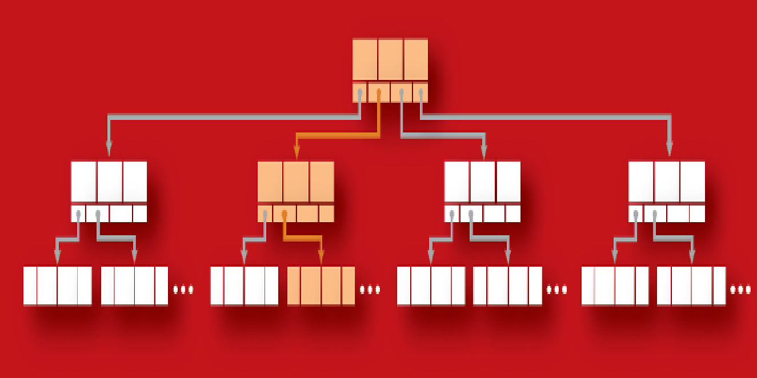
B+Trees: Lookups
Read optimized.
Single root-to-leaf pass by following pointers
between keys such that one is greater than and
other is less than (equal to) the searched term.
Point query is complete by locating the leaf node.
For range scan, key-value pairs of leaf node and
sibling leaf’s nodes are traversed.
Time complexity: Guarantees log[n] lookup as
binary search is used.
Notes:
Point query: locating a leaf node first.
For range scan, key-value pairs of leaf node and sibling leaf’s nodes are traversed until the end of the range is reached.
Guarantees log n lookup for poin query as when it comes to searching for the key within the leaf node located, we follow binary search. And for reaching till the leaf node too, log n time was needed.

Slide 11
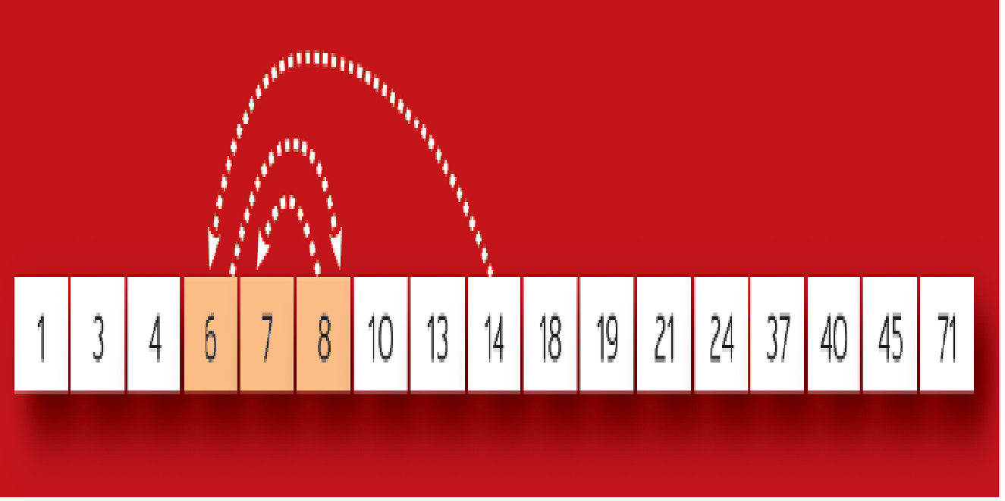
Binary Search Algorithm
Begin with middle element of the whole list
as the search key.
If search key == required key, return index/value
of search key.
Else if required key < search key, narrow the search
space to first half of the list.
Else, narrow the search space to second half of the
list.
Repeat the above steps recursively, until the required
key is found or list.size() = 0.

Slide 12
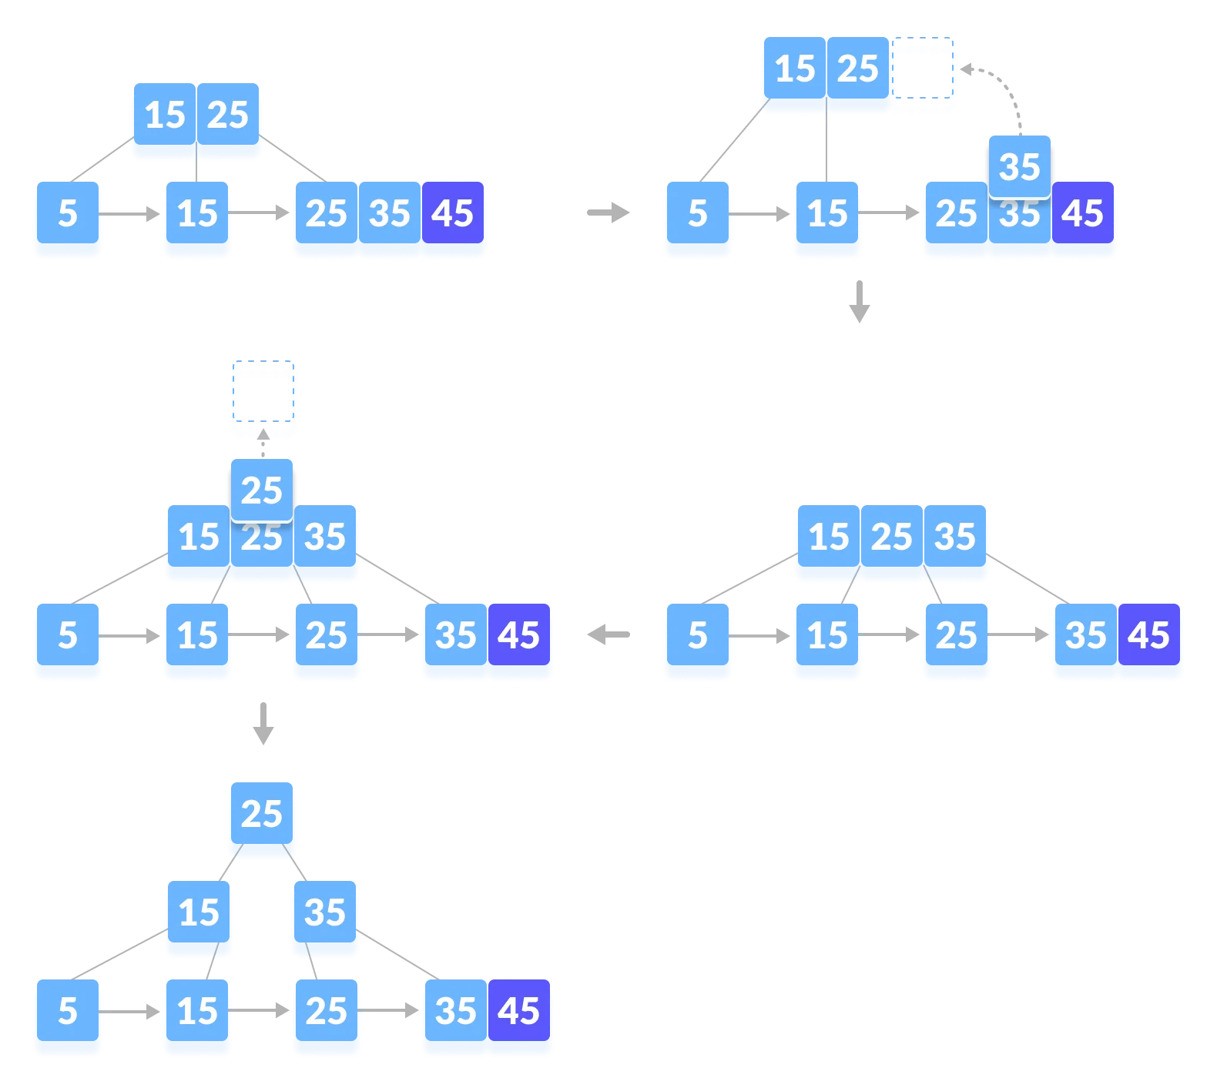
B+Trees: Insertion and Updates
First, the target leaf is acquired using the
search/lookup algorithm.
If there is enough free space, key-value is
appended to it.
Else, the condition is called overflow and
the leaf is split into 2 leaves and middle
value is sent up to the parent node.
In case of parent node overflow, the splitting
repeats uptil the root node.
Depth of tree increases only when root node
splits.
Notes:
the leaf is split into 2 leaves and a copy of the middle value (the first entry of the newly formed right leaf/node that is) is sent up to the parent node
Depth of tree increases only when root node splits, i.e., tree/height grows when root node splits.

Slide 13
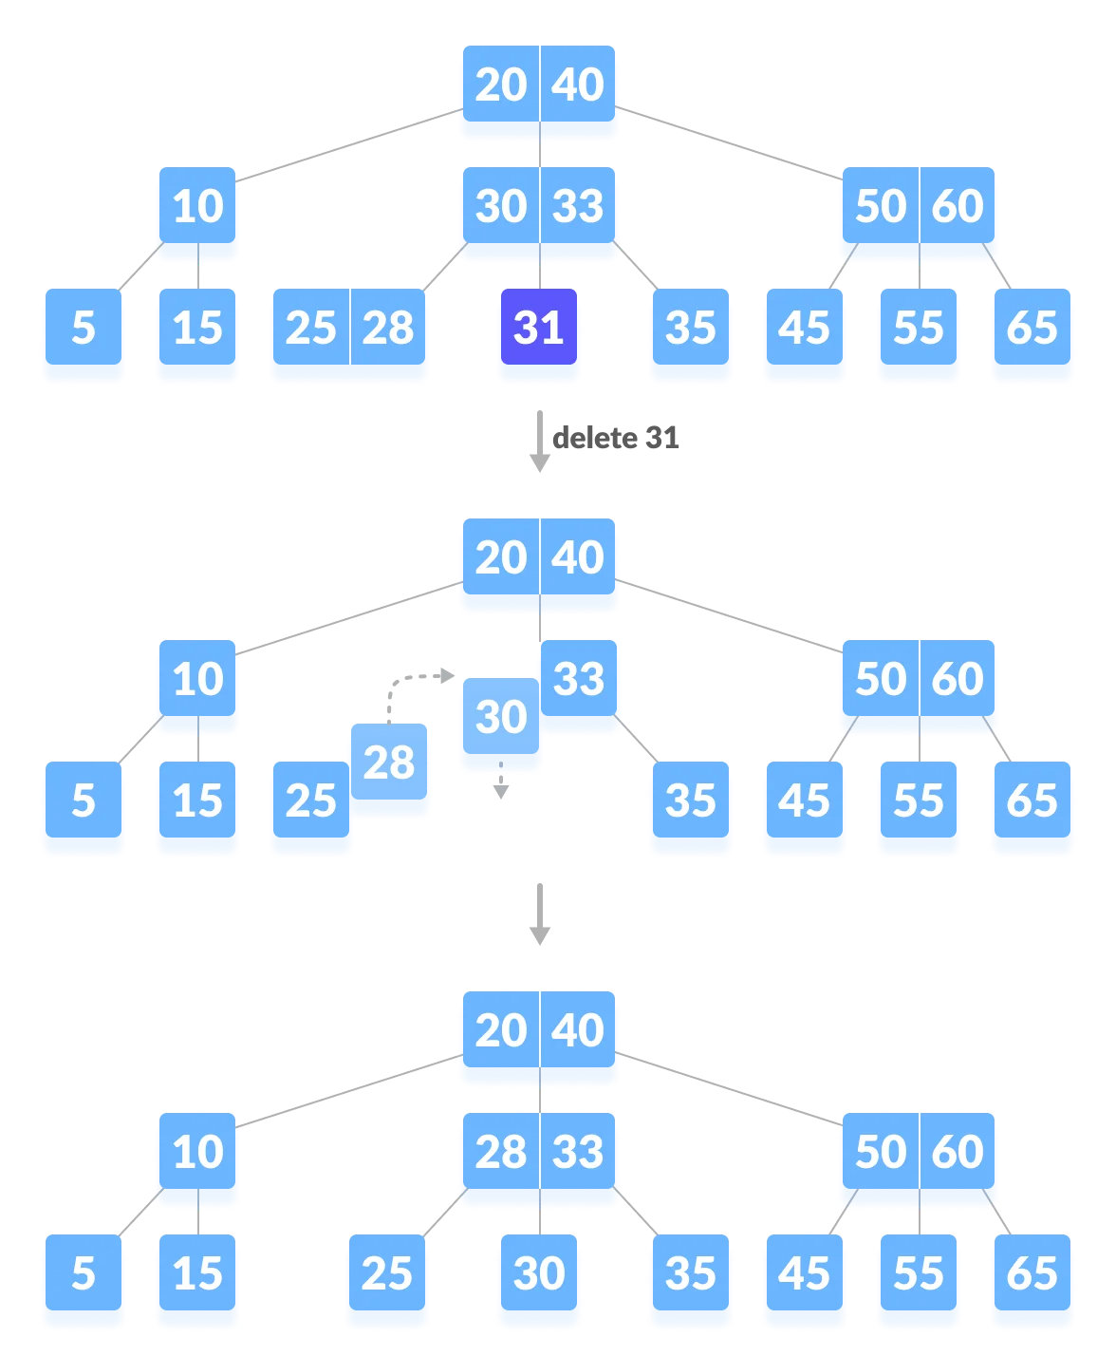
B-Trees: Deletions
Similar to Insertion, first the target leaf
is acquired through the search algorithm.
If there are enough keys in the node, key-
value pair is simply deleted.
Else, when number of keys in a node fall
below a certain threshold, the condition is
called underflow.
In case of Underflow, either borrow from
the neighbours (if they have more than
threshold keys) or merge (Coalesce’s method)
with the neighbours and parent node. In both
the cases, the parent node also participates.
Notes:
Deletion in B+Trees in similar, only with slight changes in threshold.

Slide 14

B-Trees: Tradeoffs
Cost for mutability: In-place updates require
space overhead and a more involved write
path.
Some writes may trigger a cascade of node
splits, hence becoming more expensive.

Slide 15
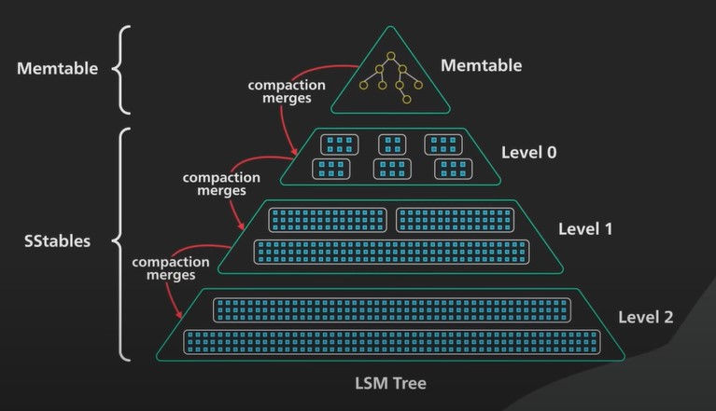
What are LSM Trees?
Write optimized: faster write speeds in comparison to B-Trees
Solves:
1. Problem with storing a lot of keys in ram (flooding) - Using disk instead
2. Range Queries (key, value) – Using sorted keys
Used In (No SQL databases): Google Big Table, Facebook Rocks DB, Cassandra, SQ Lite etc.

Slide 16
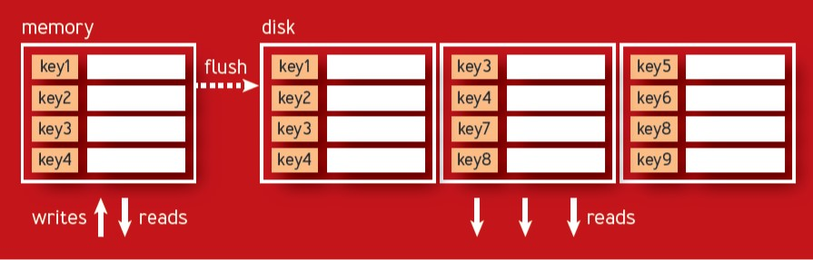
LSM Trees (Log Structured Merge Trees)
LSM Tree Breakdown
MemTable (memory resident table) – Uses Red Black Tree ~ Similar to binary tree (self balancing)
SSTables (sorted string tables) – Uses disk space ~ generally Immutable (Levelling is used for read and space optimization)
Indexes (in memory) – Keeps offset of blocks for every SSTable

Slide 17
Write Process:
In-Memory Red Black Tree
SSD/HDD
Aman | 200
Ram | 700
Ankit | 320
Aman | 220
Rohan | 133
Sumit | 222
SSTable
Aman | 200
Ankit | 300
Ram | 700
Write
Flush (at max size)
(In-order Traversal)
Ankit | 300
Time = T1
Aman | 200
Ram | 700

Slide 18
Write and Read Process:
In-Memory Red Black Tree
SSD/HDD
Aman | 200
Ram | 700
Ankit | 320
Aman | 220
Rohan | 133
Sumit | 222
SSTable
Aman | 200
Ankit | 300
Ram | 700
Write
Flush (at max size)
(In-order Traversal)
Ankit | 300
Time = T1
Aman | 200
Ram | 700
found
(3)
Write
In-Memory Red Black Tree
Flush (at max size)
(In-order Traversal)
SSTable
Aman | 220
Rohan | 133
Sumit | 222
Rohan | 133
Time = T2
(1)
(2)
T2 > T1
Read (ankit)
Aman | 220
Sumit | 222
Log(n) time in search in SSTables

Slide 19
SSTable (sorted string tables)
SSTables are key-value blocks that are sorted with respect to the keys.
For large sized SSTables - Index Tables are used for faster reads
Index Table – The SSTable divides into k sized blocks and Index Table stores the offset of the first key of each block
SSTable Key | Value
Argentina | --
:: :: :: | -- 10kb
Auction | --
:: :: :: | -- 10kb
Banana | --
:: :: :: | -- 10kb
Index Table Key | Offset
Argentina | 0
Auction | 220
Banana | 512
Only 1key per 10kb
Problem: Updating and Deleting a key requires extra space because of immutability, leading the same key to ends up in multiple SSTables
TombStone marker is used for deletion. E.g. Argentina-> tomb

Slide 20
Compaction
Time = T1
SSTable
Aman | 200
Ankit | 300
Ram | 700
Time = T2
Compaction: An algo that merges two SSTables and creates a new SSTable (of size <= 2*original size) and also removing duplicate keys in the process ~ freeing up space
The algorithm is similar to MergeSort's Merge algo
Inserting low value keys first
For same value -> inserting the latest and deleting the rest
And for tombstone -> deleting all
SSTable
Aman | 220
Ankit | 300
Ram | 700
Sumit | 222
Compaction
Time = T2
SSTable
Aman | 220
Rohan | tomb
Sumit | 222
T2 > T1
Read time = log(4) ~ 2
Read time = 2 log(3) ~ 3.16

Slide 21
Some Problems with LSM Trees
1. Reads are a bit slow
What if a key does not exist?
MemTable Read
20 SSTables Read -> few kbs in each table
Optimization => Bloom Filter
It can produce false positive matches i.e.
Is key present? -> No (then 100% not present)
-> Yes (may or may not be present)
Runtime = O(1)
2. Writes may be lost
Suppose a MemTree that has not been flushed yet (still in memory)
An crash can lead to -> data loss
Solution => WAL (Write ahead logging)
all the database state modifications are first durably persisted in the append-only log on disk
The logs can be used to create the lost MemTree again. Hence, no loss

Slide 22
Advantages of LSM Trees
High write throughput
Attractive to store data with high update rates
Minimized Storage overhead
Disadvantages of LSM Trees
Slow reads in comparison to B-Trees
Compaction process sometimes interfere with the performance of ongoing reads and writes

Slide 23
The RUM Conjecture
Database optimization parameters: read, update and memory overhead or RUM.
RUM Conjecture: setting an upper bound on two overheads, sets a lower bound on the third one.
Example: B-Trees- read optimized, write and space overhead.
Example: LSM-Trees- write optimized, less space overhead but high read overhead.
Adaptive data structures optimize desired properties with some tradeoffs like:
Trade maintenance cost for read performance.
Trade functionality for efficiency- Heap files and Hash indexes for point queries but nothing more
Trade precision for space and efficiency- approximate data structures like Bloom filter, Hyperloglog.
Notes:
Maintenance for b trees- imbalance take care. For LSM-trees- compaction.
time. Optimizing for memory efficiency using compression (for example, algorithms such as Gorilla compression,6 delta encoding, and many others) will add some overhead for packing the data on writes and unpacking it on reads.
heap files and hash indexes can provide great performance guarantees and smaller space overhead because of the file format simplicity, for the price of not being able to perform anything but point queries.

Slide 24
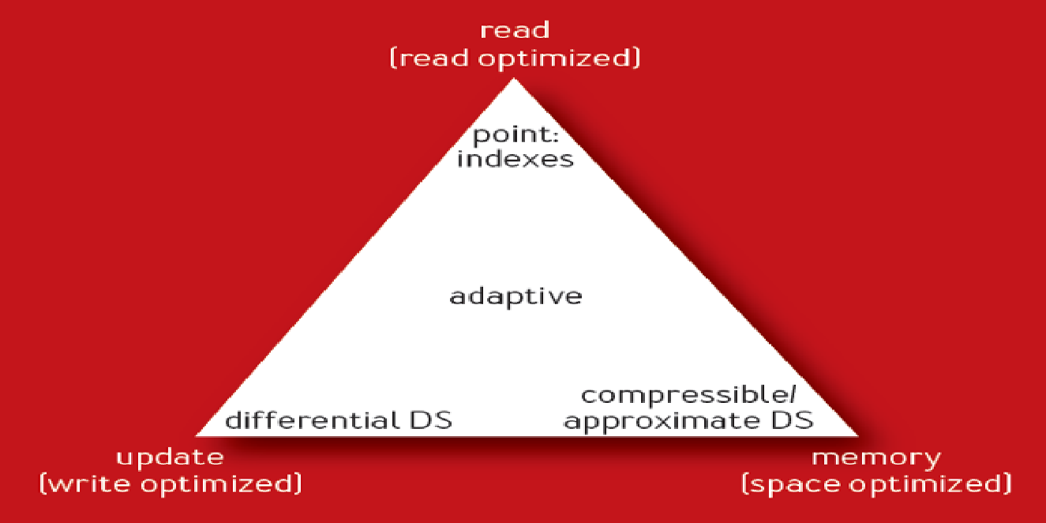
Conclusion:
The three tunables: read, write and memory
overhead and help evaluate the database and
gain deeper understanding of the workloads it’s
best suited for.
Other factors to consider: maintenance overhead,
operational simplicity, system requirements, suitability
for frequent updates, access patterns and so on.
The RUM conjecture is just a rule of thumb, to provide
the initial intuition and direction.
Notes:
Understanding your workload is the first step on the way to building a scalable back end.

Slide 25
THANK YOU
Q/A

